Slide 1
Murach’s Modern JavaScript
Chapter 8
How to work with dates, times, and timers

Slide 2
Objectives
Applied
Create a Date object from a string, numbers, another Date object, or a timestamp.
Get and set the parts of a Date object, such as year, month, day, minutes, and seconds.
Format a Date object.
Perform calculations on a Date object.
Start and stop one-time timers and interval timers.
Knowledge
Name the different parts of a Date object.
Define UTC and describe how time zones work with Date objects.

Slide 3
How the Date() constructor works with different parameters
Parameters | Creates a new Date object…
None | set to the current date and time.
String value | set to the date and time of the string.
Numeric values | set to the year, month, day, hours, minutes, seconds, and milliseconds of the numbers. Year and month are required.
Date object | that’s a copy of the Date object it received.
Timestamp | set to the milliseconds since midnight, Jan 1, 1970.

Slide 4
Six ways to create a Date object (part 1)
Get the current date and time
const now = new Date();
Specify a string using a local format
const electionDay = new Date("11/5/2024");
const grandOpening = new Date("2/16/2024 8:00");
const departureTime = new Date("4/6/2024 18:30:00");
Specify a string using the universal format
const electionDay = new Date("2024-11-05");
// UTC, not local
const grandOpening = new Date("2024-02-16T08:00");
// local time zone
const departureTime = new Date("2024-04-06T18:30:00");
// local time zone

Slide 5
Six ways to create a Date object (part 2)
Specify numeric values
const electionDay = new Date(2024, 10, 5);
// 10 is November
const grandOpening = new Date(2024, 1, 16, 8);
// 1 is February
const departureTime = new Date(2024, 3, 6, 18, 30);
// 3 is April
Copy another Date object
const today = new Date(now); // copy Date object
// from first example
Specify a timestamp
const timestampDate = new Date(1704096000000);
// 1/1/2024

Slide 6
What happens when an invalid date is passed to the Date constructor
const badDate = new Date("6/32/2024"); // Invalid date

Slide 7
Four methods for converting a Date object to a string
toString()
toDateString()
toTimeString()
toISOString()
Get a string representation of a date or time
const birthday = new Date(2001, 0, 7, 8, 25);
alert(birthday.toString());
// "Sun Jan 07 2001 08:25:00 GMT-0800"
alert(birthday.toDateString()); // "Sun Jan 07 2001"
alert(birthday.toTimeString()); // "08:25:00 GMT-0800"
alert(birthday.toISOString());
// "2001-01-07T16:25:00.000Z"

Slide 8
Some get methods of a Date object
getTime()
getFullYear()
getMonth()
getDate()
getDay()
getHours()
getMinutes()
getSeconds()
getMilliseconds()

Slide 9
Some set methods of a Date object
setFullYear(year)
setMonth(month)
setDate(day)
setHours(hour)
setMinutes(minutes)
setSeconds(seconds)
setMilliseconds(ms)

Slide 10
Format a date
const departTime = new Date(2024, 3, 16, 18, 30);
// April 16, 2024 6:30pm
// get day - pad if only 1 digit
const day =
departTime.getDate().toString().padStart(2, "0");
// get month (add 1 since month is zero based) –
// pad if only 1 digit
const month = (departTime.getMonth() + 1).toString()
.padStart(2, "0");
const year = departTime.getFullYear();
const dateText = `${year}-${month}-${day}`;
// dateText is "2024-04-16"

Slide 11
Calculate the days until the New Year
// get current date and time
const now = new Date();
// create new date for Jan 1 of following year
const newYear = new Date(now.getFullYear() + 1, 0, 1);
// get time difference in milliseconds
const timeLeft = newYear.getTime() - now.getTime();
// calculate milliseconds in a day: hrs * mins * secs
// * milliseconds
const msInOneDay = 24 * 60 * 60 * 1000;
// convert milliseconds to days
const daysLeft = Math.ceil(timeLeft / msInOneDay);
// if today is November 5, 2024, daysLeft is 57

Slide 12
Calculate a due date
const invoiceDate = new Date();
// make a copy of invoice date
const dueDate = new Date(invoiceDate);
// set the due date to 3 weeks (21 days) in the future
dueDate.setDate(invoiceDate.getDate() + 21);
// if invoice date is 9/3/2024, due date is 9/24/2024

Slide 13
Find the end of the month
const endOfMonth = new Date();
// set the month to next month
endOfMonth.setMonth(endOfMonth.getMonth() + 1);
// set the day to one day before the start of the month
endOfMonth.setDate(0);
// if today is 12/2/2024, endOfMonth is 12/31/2024

Slide 14
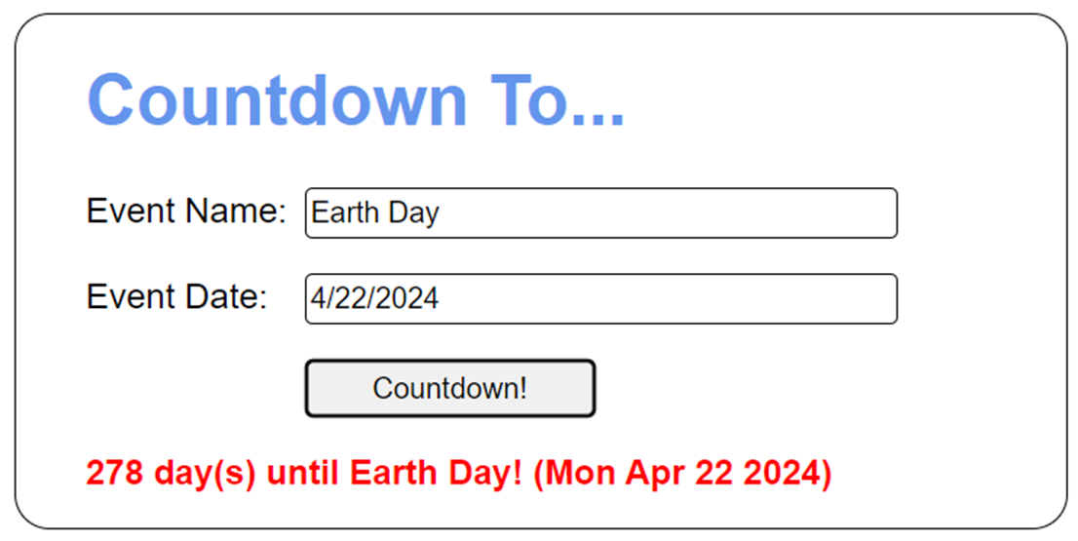
The user interface for the Countdown app

Slide 15
The <body> element for the Countdown app
<body>
<h1>Countdown To...</h1>
<div>
<label for="event">Event Name:</label>
<input type="text" id="event">
</div>
<div>
<label for="date">Event Date:</label>
<input type="text" id="date"><br>
</div>
<div>
<label>&nbsp;</label>
<button id="countdown">Countdown!</button>
</div>
<div>
<label id="message"></label>
</div>
<script src="countdown.js"></script>
</body>

Slide 16
The CSS for the message element
#message {
color: red;
font-weight: bold;
width: auto;
}

Slide 17
The JavaScript for the Countdown app (part 1)
const getElement = selector => document.querySelector(selector);
document.addEventListener("DOMContentLoaded", () => {
getElement("#countdown").addEventListener(
"click", () => {
// get the values entered by the user
const eventName = getElement("#event").value;
const eventDateString = getElement("#date").value;
// get the message label element
const messageLbl = getElement("#message");
// make sure user entered an event name and date
if (eventName == "" || eventDateString == "") {
messageLbl.textContent =
"Please enter both a name and a date.";
return;
}

Slide 18
The JavaScript for the Countdown app (part 2)
// convert event date string to Date object
// and check for validity
const eventDate = new Date(eventDateString);
if (eventDate.toString() == "Invalid Date") {
messageLbl.textContent =
"Please enter a valid date.";
return;
}
// calculate days
const today = new Date();
const msFromToday = eventDate.getTime() –
today.getTime();
const msForOneDay = 24 * 60 * 60 * 1000;
const daysToDate = Math.ceil(msFromToday /
msForOneDay);

Slide 19
The JavaScript for the Countdown app (part 3)
// create and display message
const displayDate = eventDate.toDateString();
let msg = "";
if (daysToDate == 0) {
msg = `Hooray! Today is ${eventName}! (${displayDate})`;
} else if (daysToDate > 0) {
msg = `${daysToDate} day(s) until ${eventName}!
(${displayDate})`;
} else if (daysToDate < 0) {
msg = `${eventName} happened ${Math.abs(daysToDate)}
day(s) ago. (${displayDate})`;
}
messageLbl.textContent = msg;
});
// set focus on first text box
getElement("#event").focus();
});

Slide 20
Two methods for working with a timer that calls a function once
setTimeout(function, delay)
clearTimeout(timer)

Slide 21
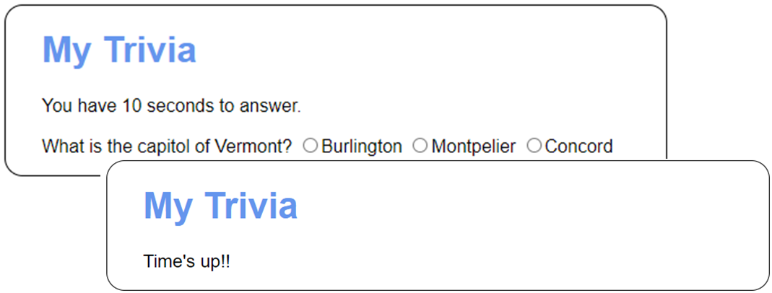
A page that times out after 10 seconds

Slide 22
Some of the HTML for the page
<h1>My Trivia</h1>
<div id="question">
<p>You have 10 seconds to answer.</p>
<label>What is the capitol of Vermont? </label>
<input type="radio" name="city" value="Burlington">
Burlington
<input type="radio" name="city" value="Montpelier">
Montpelier
<input type="radio" name="city" value="Concord">
Concord
</div>

Slide 23
The JavaScript for the page (part 1)
let timer = null;
const div = document.querySelector("#question");
const timesUp = () => div.textContent = "Time's up!!";
const processAnswer = evt => {
clearTimeout(timer);
if (evt.currentTarget.value === "Montpelier") {
div.textContent = "Correct!! The capitol of " +
"Vermont is Montpelier.";
} else {
div.textContent = "Sorry - the capitol of " +
"Vermont is Montpelier.";
}
};

Slide 24
The JavaScript for the page (part 2)
document.addEventListener("DOMContentLoaded", () => {
timer = setTimeout(timesUp, 10000); // 10 secs
const options = div.querySelectorAll("input");
for (let opt of options) {
opt.addEventListener("click", processAnswer);
}
});

Slide 25
Two methods for working with a timer that calls a function repeatedly
setInterval(function, interval)
clearInterval(timer)

Slide 26
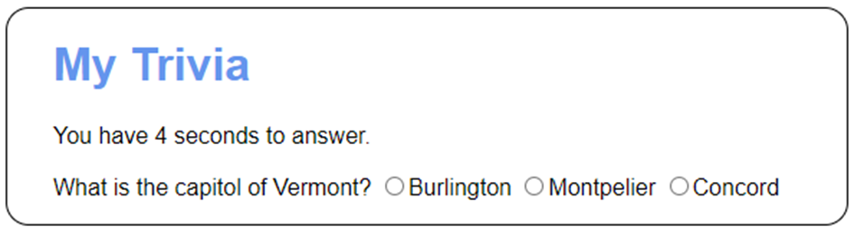
The page updated to count down
The updated HTML for the <p> element
<p>You have <span id="seconds">10</span> seconds to answer.</p>

Slide 27
The JavaScript for the updated page (part 1)
let timer = null;
const div = document.querySelector("#question");
const updateTime = () => {
const span = document.querySelector("#seconds");
const seconds = parseInt(span.textContent) - 1;
if (seconds == 0) {
clearInterval(timer);
div.textContent = "Time's up!!";
} else {
span.textContent = seconds;
}
};

Slide 28
The JavaScript for the updated page (part 2)
const processAnswer = evt => {
clearInterval(timer);
if (evt.currentTarget.value === "Montpelier") {
div.textContent = "Correct!! The capitol of " +
"Vermont is Montpelier.";
} else {
div.textContent = "Sorry - the capitol of " +
"Vermont is Montpelier.";
}
};
document.addEventListener("DOMContentLoaded", () => {
timer = setInterval(updateTime, 1000); // 1 sec
const options = div.querySelectorAll("input");
for (let opt of options) {
opt.addEventListener("click", processAnswer);
}
});

Slide 29
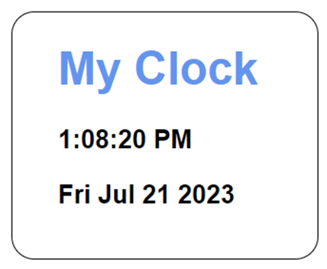
The Clock app
Some of the HTML
<h1>My Clock</h1>
<p id="time"></p>
<p id="date"></p>

Slide 30
The JavaScript for the Clock app (part 1)
const getElement = selector => document.querySelector(selector);
const padValue = value => value.toString().padStart(2, "0");
const displayClock = () => {
// calculate and format current time and date
const now = new Date();
const ampm = (now.getHours() >= 12) ?
"PM" : "AM";
const hours = (now.getHours() > 12) ?
now.getHours() - 12 : now.getHours();
const minutes = padValue(now.getMinutes());
const seconds = padValue(now.getSeconds());
// display time and date
getElement("#time").textContent =
`${hours}:${minutes}:${seconds} ${ampm}`;
getElement("#date").textContent = now.toDateString();
};

Slide 31
The JavaScript for the Clock app (part 2)
document.addEventListener("DOMContentLoaded", () => {
// set initial clock time and start interval for clock
displayClock();
setInterval(displayClock, 1000);
});

Slide 32
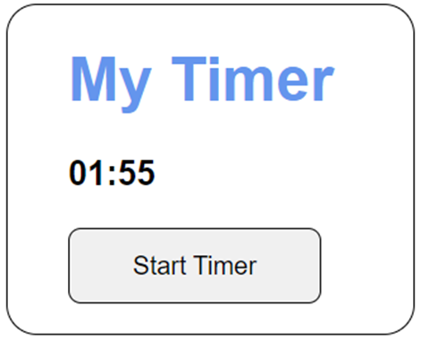
The Timer app
Some of the HTML
<h1>My Timer</h1>
<p id="display_timer"></p>
<button id="start_timer">Start Timer</button>

Slide 33
The JavaScript for the Timer app (part 1)
let timer = null;
let endTime = null;
const getElement = selector =>
document.querySelector(selector);
const padValue = value =>
value.toString().padStart(2, "0");
const displayTimer = () => {
const now = new Date();
const diff = endTime.getTime() - now.getTime();
if (diff <= 0) {
clearInterval(timer);
getElement("#display_timer").textContent = "";
alert("Time's up!!");
} else {
const timerDate = new Date(diff);
const minutes = padValue(timerDate.getMinutes());
const seconds = padValue(timerDate.getSeconds());
getElement("#display_timer").textContent =
`${minutes}:${seconds}`;
}
};

Slide 34
The JavaScript for the Timer app (part 2)
const startTimer = () => {
let minutes = NaN;
while (!(minutes > 0 && minutes < 10)) {
minutes = parseInt(prompt(
"Please enter 1 to 10 minutes."));
}
endTime = new Date();
endTime.setMinutes(endTime.getMinutes() + minutes);
displayTimer();
timer = setInterval(displayTimer, 1000);
};
document.addEventListener("DOMContentLoaded", () => {
getElement("#start_timer").addEventListener("click",
startTimer);
});

Slide 35

The Slide Show app

Slide 36
Some of the HTML for the Slide Show app
<h1>Fishing Slide Show</h1>
<ul id="image_list">
<li><a href="images/release.jpg"
title="Catch and Release"></a></li>
<li><a href="images/deer.jpg"
title="Deer at Play"></a></li>
<li><a href="images/hero.jpg"
title="The Big One!"></a></li>
<li><a href="images/bison.jpg"
title="Roaming Bison"></a></li>
</ul>
<p><img id="main_image"></p>
<h2 id="caption"></h2>
The CSS for the <ul> element
ul {
display: none;
}

Slide 37
The JavaScript for the Slide Show app (part 1)
const getElement = selector =>
document.querySelector(selector);
document.addEventListener("DOMContentLoaded", () => {
// get elements for the image and caption
const mainImage = getElement("#main_image");
// the <img> element
const caption = getElement("#caption");
// the <h2> element
// get all the <a> elements in the <ul> element
const links =
document.querySelectorAll("#image_list a");
// process images
const imageCache = [];
let image = null;

Slide 38
The JavaScript for the Slide Show app (part 2)
for (let link of links) {
// Preload image
image = new Image();
image.src = link.href;
image.alt = link.title;
// add image to array
imageCache.push(image);
}
// set initial image and caption
mainImage.src = imageCache[0].src;
mainImage.alt = imageCache[0].alt;
caption.textContent = imageCache[0].alt;

Slide 39
The JavaScript for the Slide Show app (part 3)
// start slide show
let imageCounter = 0;
setInterval(() => { // first parameter –
// anonymous function
// calculate the index for the current image
imageCounter = (imageCounter + 1) %
imageCache.length;
// get image object from array
image = imageCache[imageCounter];
// set image and caption with values
// from image object
mainImage.src = image.src;
mainImage.alt = image.alt;
caption.textContent = image.alt;
},
2000); // second parameter - 2 second interval
});

